Slide 1

ID&T Job Ads & Data Collection
Higher Education & K-12
EME 610- Spring 2014
Benson Callier, Megan Cardillo, Chengyan Lin & Stephan Martinez
Notes:
Image: www.whitehouse.gov

Slide 2

Introduction
•Job ads search- Higher education & K-12
•Various characteristics of ID&T field
•Main source of data collection- Websites
Notes:
The goal of this project is to introduce Instructional Design and Technology job qualifications and discuss its various characteristics. Our group specifically focused on higher education and K-12 job advertisements. Our main source for data collection was job search websites, such as the Chronicle of Higher Education, Higheredjobs.com, and various others. This report will cover the websites searched, types of appointments, types of degrees, degree names, research and delivery skills, knowledge, and theories.
Image: atimetocherish.photography

Slide 3
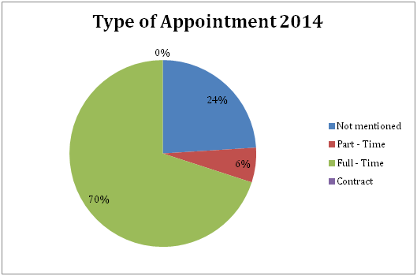
Type of Appointment
Notes:
Within the Academic field of Instructional Design and Technology, there are various types of appointment, including full-time, part-time, and contract). The majority of the job ads analyzed for this component listed the type of appointment, but there were job ads that did not mention a type.
As shown in Figure 3, the majority (74%) of jobs analyzed listed a full-time description, and only 6% were listed as part-time. Examples of the part-time jobs include an Academic Program Specialist, an online Physical Education Teacher, and an Educational Media Instructional Designer. These positions offer no trend for part time listings; it seems that these jobs are just needed part-time at this time.
The remaining ads did not mention a type of appointment (24%). A large amount of these ads can be assumed to have a full-time requirement, based on description.

Slide 4
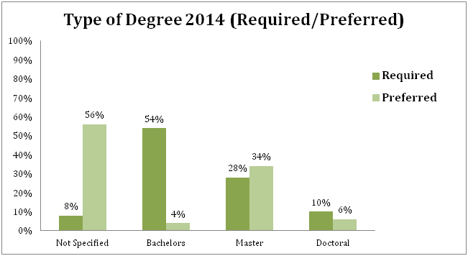
Type of Degree
Notes:
In addition, certain degrees were specified as required or preferred in these job ad listings, in addition to a small amount having no specification.
As shown in Figure 4, the majority (54%) of these postings required a Bachelors degree, 28% required a Masters, and only 10% required a Doctoral degree. Positions requiring a Bachelors degree were very similar to certain ones requiring a Masters; an example includes two Professional Development positions; the Professional Development Specialist for K-8 requires a Bachelors degree, where as the Professional Development Consultant for K-12 e-learning requires a Masters degree. It seems that the Masters degree requirement pertains to mostly coordinators, directors, and actual University Instructors. These positions tend to have more responsibilities. The Doctoral degree requirements were mostly for Instructors in a Doctorate program.
In regards to preferred degree, the majority (56%) only mentioned required degrees. A Masters degree was the most preferred (34%), and a Doctoral degree was preferred next at 6%. Only 4% of the job ads preferred a Bachelor’s degree; this seems to stem from the fact that a majority of the job listings required this degree type.

Slide 5
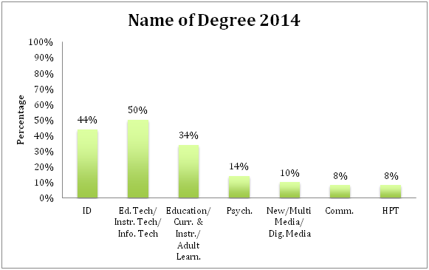
Name of Degree
Notes:
In addition to the degree type, many of these job ads also mentioned specific degree names, including Instructional Design, Educational Technology/Instructional Technology/Information Technology, Education/Curriculum and Instruction/Adult Learning, Psychology, New Media/Multi Media/Digital Media, Communications, and HPT.
As shown in Figure 5, 50% of the degrees mentioned included Educational Technology/Instructional Technology/Information Technology. Instructional Design proceeded with 44% of the ads mentioning this degree, followed by Education/Curriculum and Instruction/Adult learning at 34%, and Psychology at 14%. The least mentioned degree names included Communications and HPT (both at 8%).
It seems that the majority were Educational Technology/Instructional Technology/Information Technology and then Instructional Design because of the job search criteria. Most of these degree types are used interchangeably, which was noted in the analysis between similar job types.

Slide 6
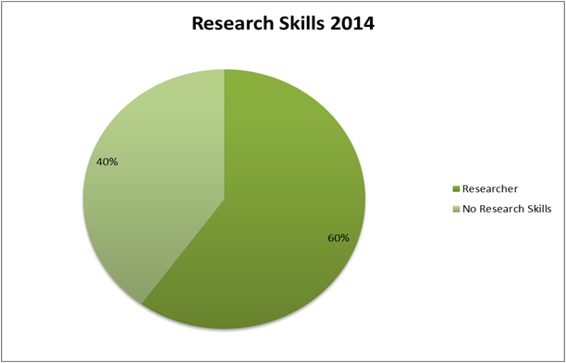
Research Skills
40.00%
2014
Research Skills | 30 | 60.00%
No Research Skills | 20 | 40.00%

Slide 7
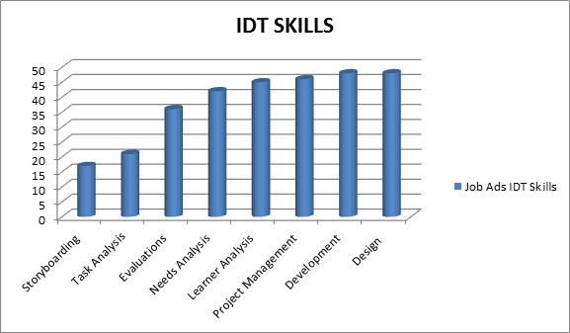
ID&T Skills
90%
92%
96%
96%
84%
72%
42%
34%

Slide 8
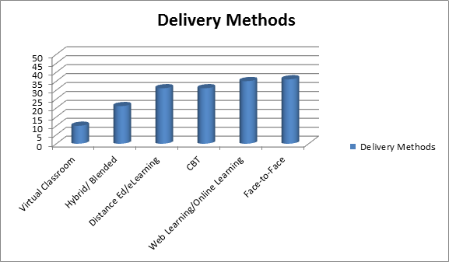
Delivery Skills
70%
72%
62%
62%
42%
20%

Slide 9
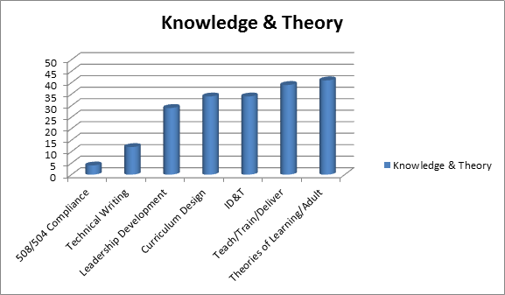
Knowledge & Theories
78%
82%
68%
68%
58%
24%
.08%

Slide 10
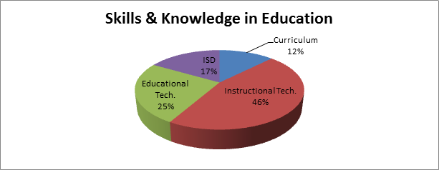
Trends to Note

Slide 11
Software Experience: Top Mentions
MS Office Suite: 68%
Blackboard: 14%
Moodle: 12%
Captivate: 8%
Articulate: 6%
Dreamweaver: 10%
Adobe Suite: 8%
HTML: 12%
Web 2.0: 10%
The analysis showed that organizations seek individuals that have experience engaging productivity, creative, and web development software programs.

Slide 12
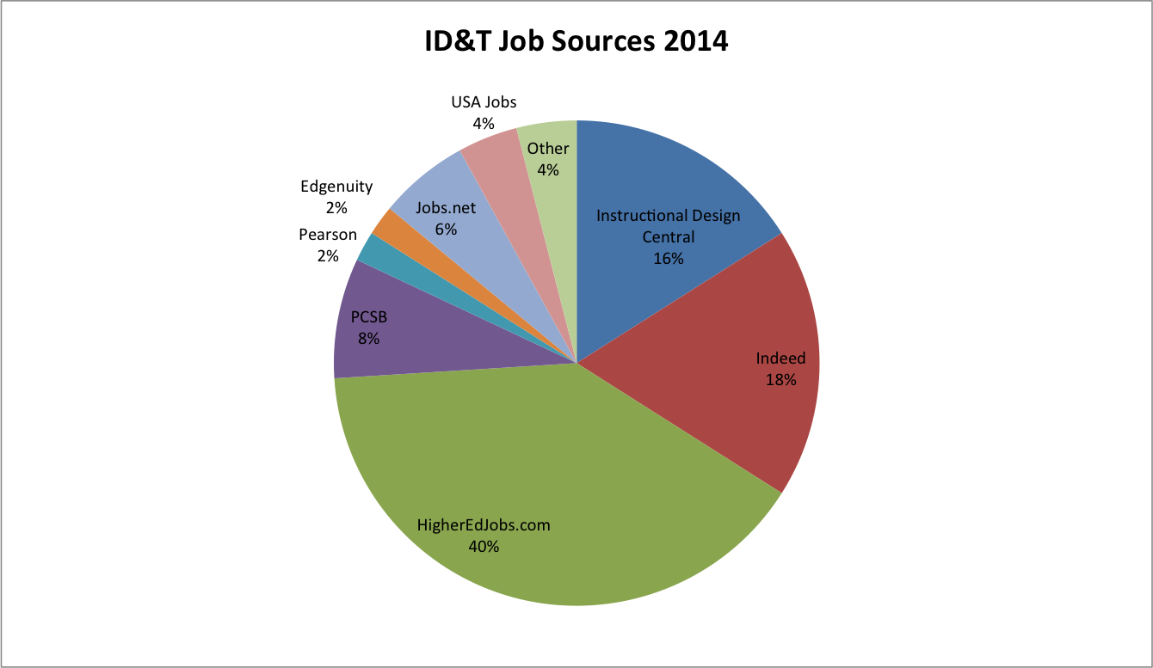
Job Source: Websites

Slide 13
Conclusion (Open Discussion Questions)
What are some of the intangible qualities that employers seek in potential employees in education?

Slide 14
Conclusion (Open Discussion Questions)
Challenges and lessons learned from this assignment?

Slide 15
Conclusion (Open Discussion Questions)
Questions, comments, or conflicts with data?

