Slide 1

Corporate Job Ad Analysis
Karen Garcia, Kaitlin Gibbons, Adin Lohry, Jennifer McIntosh, and Steven David Torres
EME 610: Trends & Issues in ID&T
Dr. Romero-Hall
April 1, 2014

Slide 2

Objectives
Explain the purpose of a job analysis
Explain what Corporate employers are seeking in candidates in Instructional Design and Technology in regards to:
  Location (Region, State and Continent)
  Job Source
  Type and Name of Degree
  Skills in:
    Research
    IDT
    Knowledge/Theories
  Delivery Method
  Software Experience
Explain the common and unusual trends among the regions
Notes:
Insert a map of your country.

Slide 3

Purpose of a Job Analysis
For the employer:
Prepare job descriptions
Job specifications
For the Job Seeker/Candidate:
Determine the important tasks
How they are to be carried out
The necessary qualities needed
    Entrepreneur, 2014

Slide 4
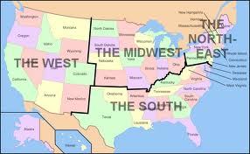
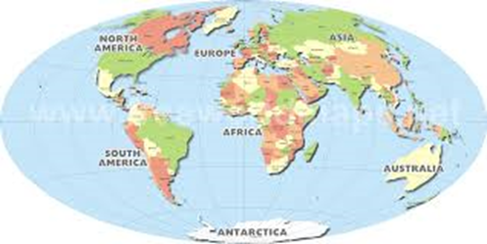
Location - Region
The United States
Mid-West
North-East
South
West
International
Europe
Asia
Notes:
Insert a picture of one of the geographic features of your country.

Slide 5
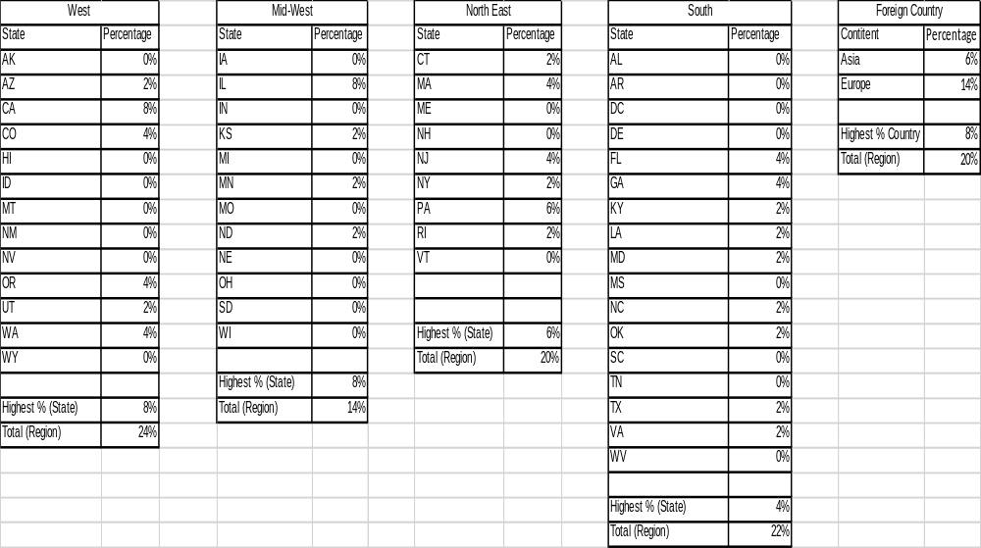
Location – State/Continent

Slide 6

Job Source
Notes:
Insert a picture of an animal and or plant found in your country.

Slide 7

Type & Name of Degree
Notes:
found in your country.

Slide 8

Research Skills
Notes:
Insert a picture of an animal and or plant found in your country.

Slide 9

IDT Skills
Notes:
Insert a picture of an animal and or plant found in your country.

Slide 10
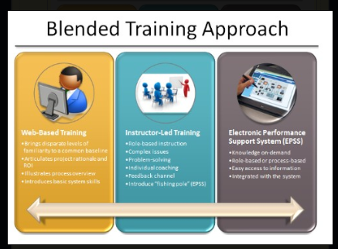
Delivery Method
Notes:
Insert a picture of an animal and or plant found in your country.

Slide 11

Knowledge& Theory Skills
Notes:
Insert a picture of an animal and or plant found in your country.

Slide 12

Software Experience
Notes:
Insert a picture illustrating a season in your country.

Slide 13
Common and Unusual Trends
International Region:
  Concealed identity of the employer
  very specific requirements for technological and software proficiencies
  Only one of the job listings identified the need of language fluency
Mid West
  Search did not yield many corporate IDT jobs
  9 ads called for minimum 3 years training/IDT experience
  4 ads requested 25-75% travel
  3 ads preferred masters degrees
North East
  Search did not yield many corporate IDT jobs
  All required Bachelors, 1 required masters
  3 ads requested no more than 20% travel
  1 ad requested HIPPA knowledge, 1 ad requested ASTD certification

Slide 14
Common and Unusual Trends cont.
South
  Bachelors Degree was preferred/required for most. 1 requested Masters Degree
  Accepted variety of degree titles
  Specific requirements for technological and software proficiencies
  1 ad requested ASTD Certification
West
  Bachelors degree preferred
  Mainly web based delivery
  1 ad requested experience with Screenflow and Gliffy

Slide 15

Conclusion and Questions

Slide 16
Reference
CareerBuilder. (2014). Search Jobs. Retrieved from http://www.careerbuilder.com/?siteid=ppc_brd_5060_kw997637&gclid=CKqSxoqAuL0CFWdk7Aod2jAAnw
Dice. (2014). Search Jobs. Retrieved from http://www.dice.com/
Eurojobs. (2014). Search Jobs. Retrieved from http://www.eurojobs.com/
HigherEdJobs. (2014). Quick Search. Retrieved from http://www.higheredjobs.com/
Indeed. (2014). What. Retrieved from http://www.indeed.com/
Jobvertise. (2014). Search Jobs. Retrieved from http://www.jobvertise.com/
LinkedIn Corporation. (2014). Jobs. Retrieved from http://www.linkedin.com/job/home?trk=hb_tab_jobs_top
SearchEuropeanJobs. (2014). What. Retrieved from http://searcheuropeanjobs.com/
SimplyHired. (2014). Job title, skills or company. Retrieved from http://www.simplyhired.com/a/simplyhired-home-page/home?gclid=CJ-R-MqFuL0CFU4R7AoddTQASA
Totaljobs.com. (2014). Enter your Keywords. Retrieved from http://www.totaljobs.com/
U.S. Cellular. (2014). Search Jobs. Retrieved from http://www.uscellular.jobs/search?q=
Notes:
Insert a picture of one of the points of interest for your country.

